Slide 1
DBSCAN & HDBSCAn Clustering
What it is?
python implementation
Use cases

Slide 2
Concepts of density-based clustering
DBSCAN (Density-Based Spatial Clustering of Applications with Noise) is a popular clustering algorithm, is used in machine learning to separate clusters of high density from clusters of low density
DBSCAN can sort data into clusters of varying shapes
Partitioning methods K-means and hierarchical clustering are suitable for finding spherical-shaped clusters or convex clusters.
work well for compact and well separated clusters.
severely affected by the presence of noise and outliers in the data.

Slide 3
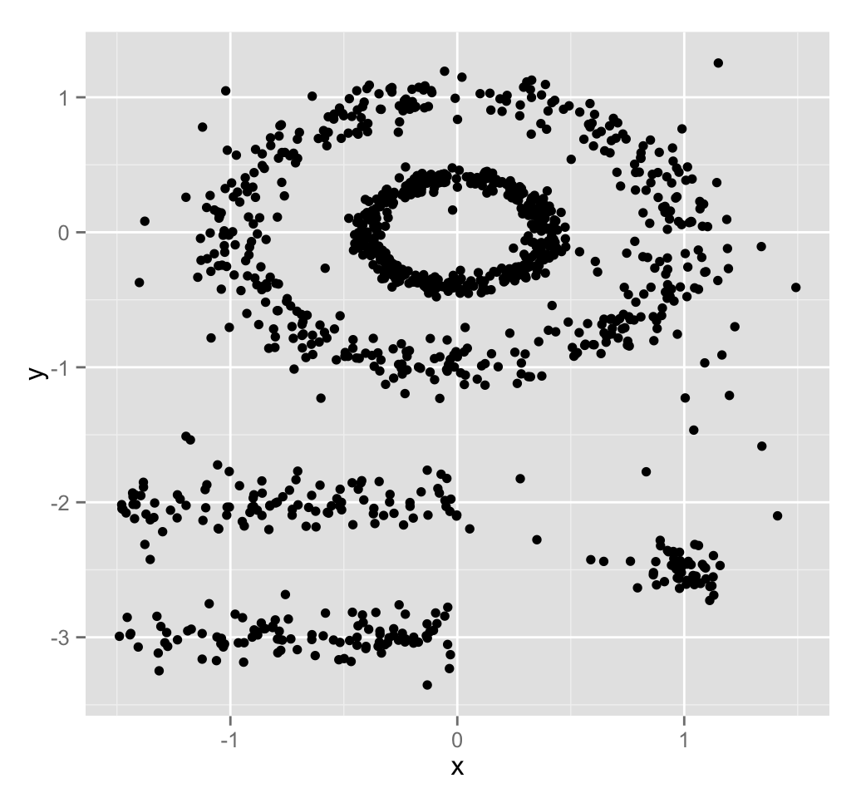
Concepts of density-based clustering
Unfortunately, real life data can contain:
clusters of arbitrary shape such as those shown in the figure below (oval, linear and “S” shape clusters)
many outliers and noise.
dataset containing nonconvex clusters and outliers/noises.
The plot above contains 5 clusters and outliers, including:
2 ovals clusters
2 linear clusters
1 compact cluster

Slide 4
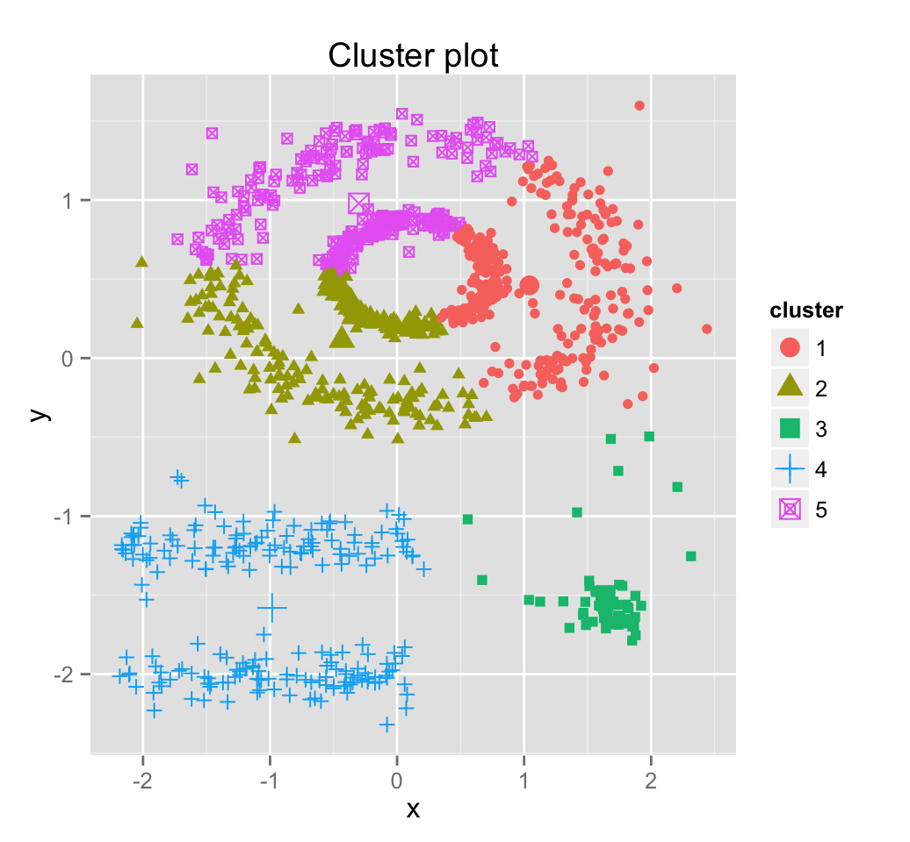
How kmeans would work
We know there are 5 five clusters in the data, but it can be seen that k-means method inaccurately identify the 5 clusters.

Slide 5
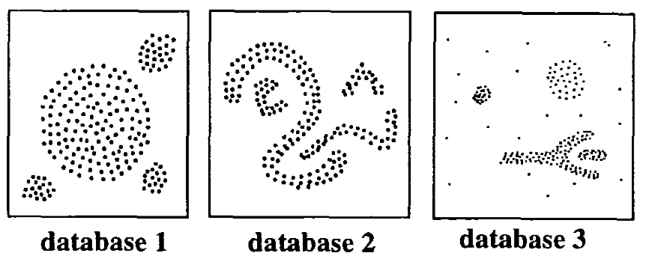
Intuition – example 1
The basic idea behind density-based clustering approach is derived from a human intuitive clustering method.
one can easily identify four clusters along with several points of noise, because of the differences in the density of points.

Slide 6
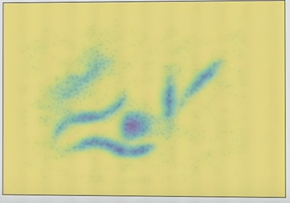
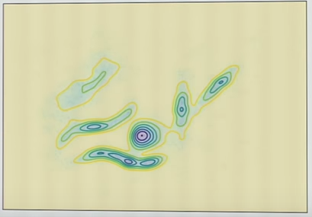
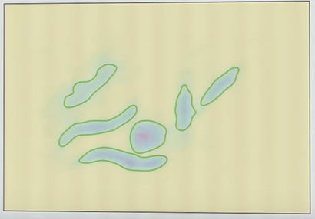
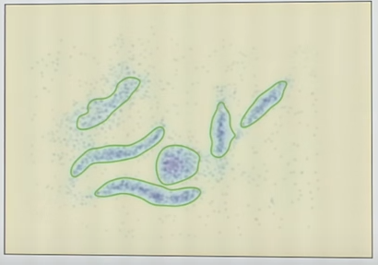
Intuition – example 2
Contours based clusters

Slide 7
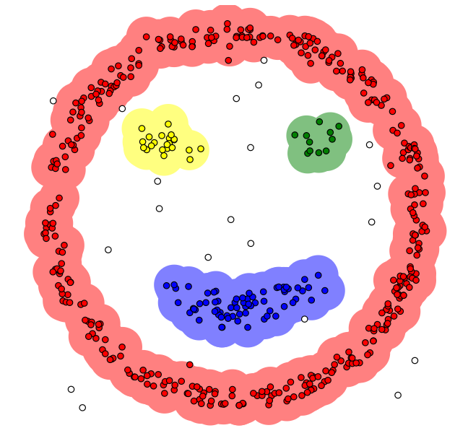
Algorithm of DBSCAN
The goal is to identify dense regions, which can be measured by the number of objects close to a given point.
2 important parameters are required for DBSCAN:
epsilon (“eps”) and
minimum points (“MinPts”).
The parameter eps defines the radius of neighborhood around a point x. It’s called the ϵ-neighborhood of x.
The parameter MinPts is the minimum number of neighbors within “eps” radius.
https://www.naftaliharris.com/blog/visualizing-dbscan-clustering/

Slide 8
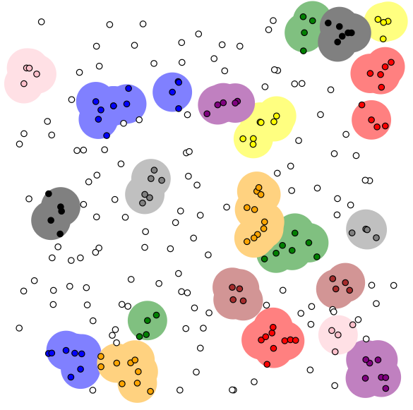
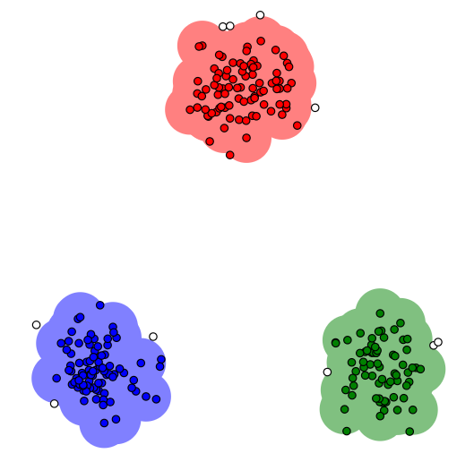
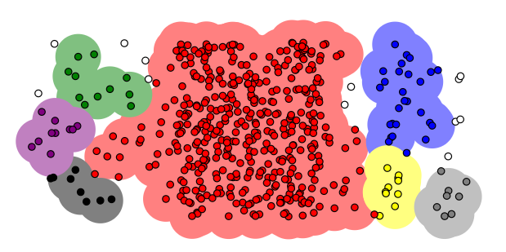
More examples of dbscan
epsilon = 1.00
minPoints = 4

Slide 9
Algorithm of DBSCAN
Any point x in the dataset, with a neighbor count greater than or equal to MinPts, is marked as a core point.
We say that x is border point, if the number of its neighbors is less than MinPts, but it belongs to the ϵ-neighborhood of some core point z.
Finally, if a point is neither a core nor a border point, then it is called a noise point or an outlier.

Slide 10
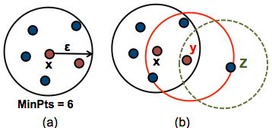
Algorithm of DBSCAN
The figure below shows the different types of points (core, border and outlier points) using MinPts = 6.
Here x is a core point because neighbours ϵ (x)=6, y is a border point because neighboursϵ(y) < MinPts, but it belongs to the ϵ-neighborhood of the core point x.
Finally, z is a noise point.

Slide 11
Core Points:
Core Points are the foundations for our clusters are based on the density
ɛ is used to compute the neighborhood for each point, so the size/volume of all the neighborhoods is the same.
The volume of each neighborhood is constant and the mass of neighborhood is variable
core points are data points that satisfy a minimum density requirement.
by adjusting our minPts parameter, we can fine-tune how dense our clusters must be.

Slide 12
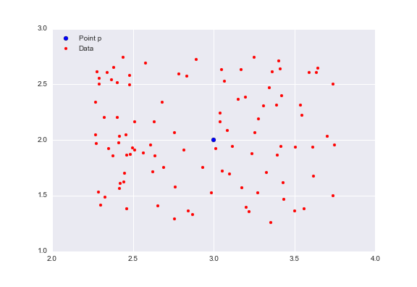
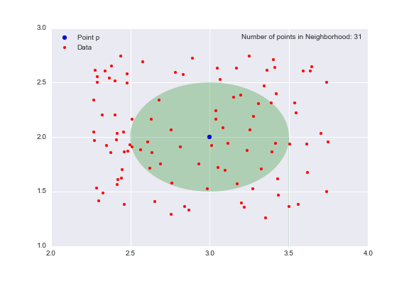
example
consider the neighborhood of p with radius 0.5 (ɛ = 0.5), the set of points that are distance 0.5 away from p.
green oval represents our neighborhood, and there are 31 data points in this neighborhood.

Slide 13
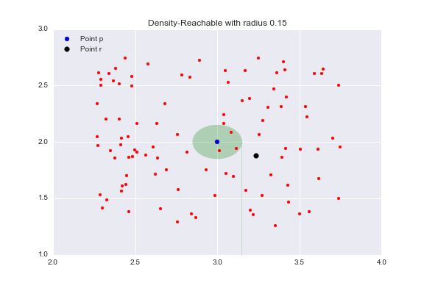
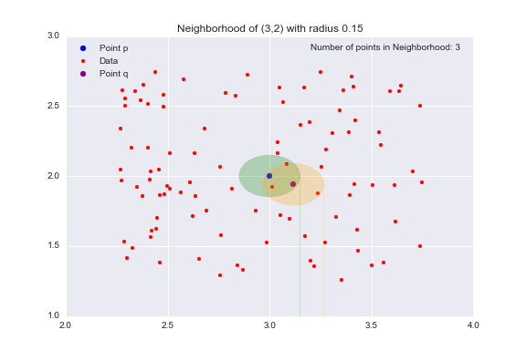
Border point
Border Points are the points in our clusters that are not core points.
epsilon = 0.15.
the point r (the black dot) outside of the point p‘s neighborhood.
All the points inside the point p‘s neighborhood are directly reachable from p.
yellow circle represents q‘s neighborhood.
Target point r is not in point p‘s neighborhood, it is contained in the point q‘s neighborhood.
This is the idea behind density-reachable

Slide 14
Algorithm of DBSCAN
Direct density reachable: | Density reachable: | Density connected:
A point “A” is directly density reachable from another point “B” if: “A” is in the ϵ-neighborhood of “B” and “B” is a core point. | A point “A” is density reachable from “B” if there are a set of core points leading from “B” to “A. | Two points “A” and “B” are density connected if there are a core point “C”, such that both “A” and “B” are density reachable from “C”.

Slide 15
steps
For each point x_{i}, compute the distance between x_{i} and the other points.
Finds all neighbor points within distance eps of the starting point (x_{i}).
Each point, with a neighbor count greater than or equal to MinPts, is marked as core point or visited.
For each core point, if it’s not already assigned to a cluster, create a new cluster.
Find recursively all its density connected points and assign them to the same cluster as the core point.
Iterate through the remaining unvisited points in the dataset.
Those points that do not belong to any cluster are treated as outliers or noise.

Slide 16
Another view …
Pick a point at random that has not been assigned to a cluster or been designated as an outlier.
Compute its neighborhood to determine if it’s a core point.
If yes, start a cluster around this point.
If no, label the point as an outlier.
Once we find a core point and thus a cluster, expand the cluster by adding all directly-reachable points to the cluster.
Perform “neighborhood jumps” to find all density-reachable points and add them to the cluster.
If an outlier is added, change that point’s status from outlier to border point.
Repeat these steps until all points are either assigned to a cluster or designated as an outlier.

Slide 17
summary
algorithm has 2 parameters:
ɛ: The radius of our neighborhoods around a data point p.
minPts: The minimum number of data points you want in a neighborhood to define a cluster.
Using these two parameters, DBSCAN categories the data points into three categories:
Core Points: A data point p is a core point if Nbhd(p, ɛ) [ɛ-neighborhood of p] contains at least minPts ; |Nbhd(p,ɛ)| >= minPts.
Border Points: A data point q is a border point if Nbhd(q, ɛ) contains less than minPts data points, but q is reachable from some core point p.
Outlier: A data point o is an outlier if it is neither a core point nor a border point. Essentially, this is the “other” class.

Slide 18
Computation time
 | Number of data points
Interactive basis ( 3 mins or so) | 100,000
In 5 to 8 mins | 500,000
In 20 to 30 minutes | 1,000,000
In 8 to 12 hours | 10,000,000

Slide 19
Pros & cons
Advantages of DBSCAN: | Disadvantages of DBSCAN
Is great at separating clusters of high density versus clusters of low density within a given dataset. | Does not work well when dealing with clusters of varying densities. While DBSCAN is great at separating high density clusters from low density clusters, DBSCAN struggles with clusters of similar density.
Is great with handling outliers within the dataset. | Struggles with high dimensionality data.

Slide 20
HDBSCAN
HDBSCAN is a clustering algorithm developed by Campello, Moulavi, and Sander.
Extends DBSCAN by converting it into a hierarchical clustering algorithm and then using a technique to extract a flat clustering based in the stability of clusters.
Before we get started we’ll load up most of the libraries we’ll need in the background, and set up our plotting (because I believe the best way to understand what is going on is to actually see it working in pictures).

Slide 21
HDBSCAN
HDBSCAN - Hierarchical Density-Based Spatial Clustering of Applications with Noise.
Performs DBSCAN over varying epsilon values and integrates the result to find a clustering that gives the best stability over epsilon. This allows HDBSCAN to find clusters of varying densities (unlike DBSCAN), and be more robust to parameter selection.
HDBSCAN is ideal for exploratory data analysis; it’s a fast and robust algorithm that you can trust to return meaningful clusters (if there are any).

